Slide 1
Prices and details of sold cars in India
The data set gives the information related to the sold cars such as sold price, mileage of the car, the tear in which it was sold , company etc.,
We are going to perform various statistical operations on the data set to analyze the data and draw conclusions from the obtained results.
We use python as it includes various libraries which is easy to access for performing the operations.

Slide 2

1.Exploratory Data Analysis
The data set contains 12 columns and 661 rows.
There are 7 categorical columns and 5 numerical columns.
In numerical columns there are two discrete data columns and three continuous data columns.
We usually read the CSV file to a Data Frame in python using pandas library
We use the below code for it:

Slide 3
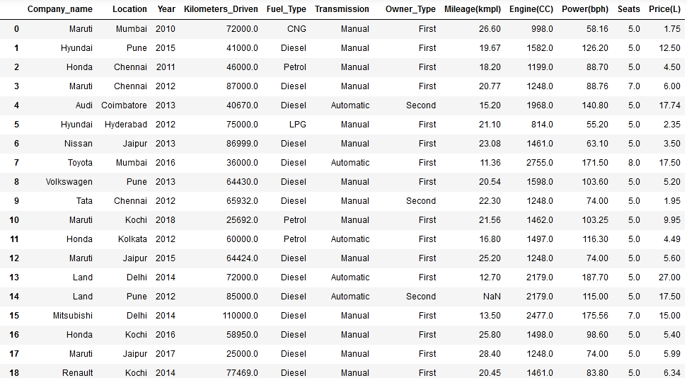

Slide 4
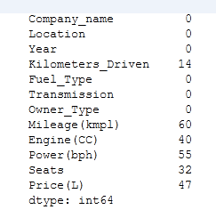

As shown in the data frame columns : company name, Location, Year, Fuel type, transmission, owner type, seats belong to the categorical set and columns:
Kilometers driven, Mileage(kmpl), Engine(CC), Power(bph),Price(L) belongs to numerical set.
There are also NAN values which is not be ignored. To know the no.of NAN values we execute the following code:
We get the
no.of NAN values column
wise

Slide 5
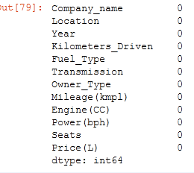
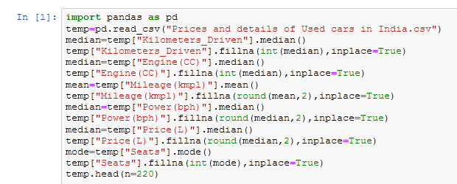
Filling NA Values :
The nan values cant be just ignored so it has to be filled with some values so for :
Categorical : mode
Numerical : mean or median
Is calculated with respect to those columns and then filled.
Code:

Slide 6
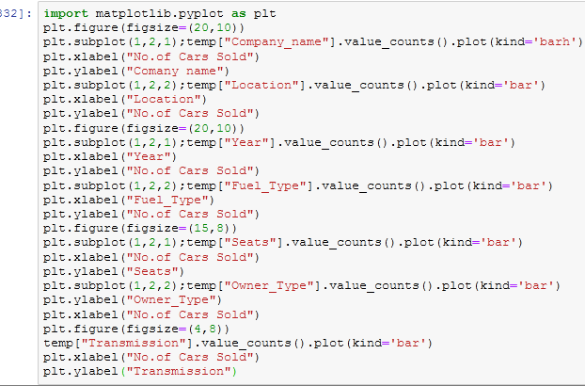
2.Graph Visualization
Graphical representation of the data is better as it can easily be understood by looking at it .
We usually use bar charts for categorical data and histograms or boxplots for numerical data.
Categorical data Code:

Slide 7
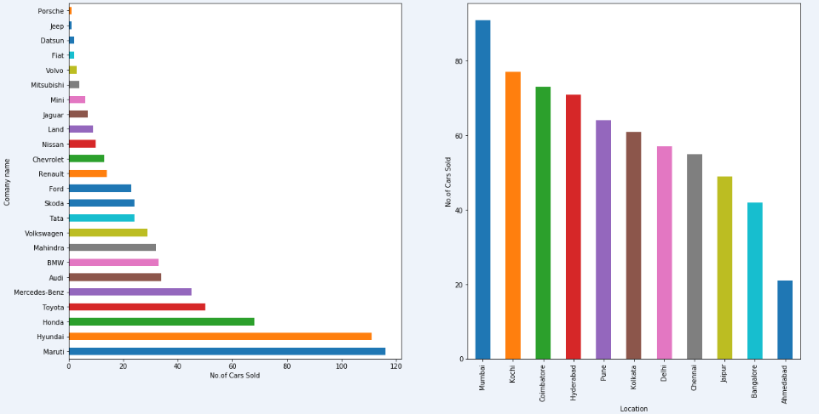

Slide 8
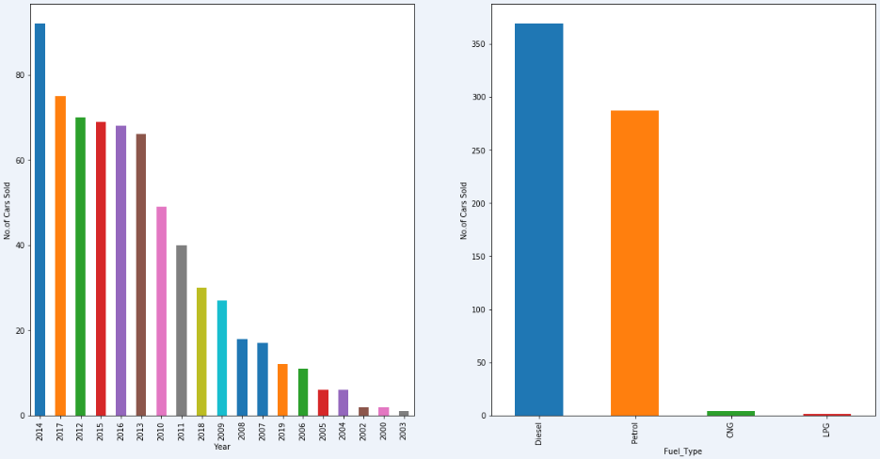
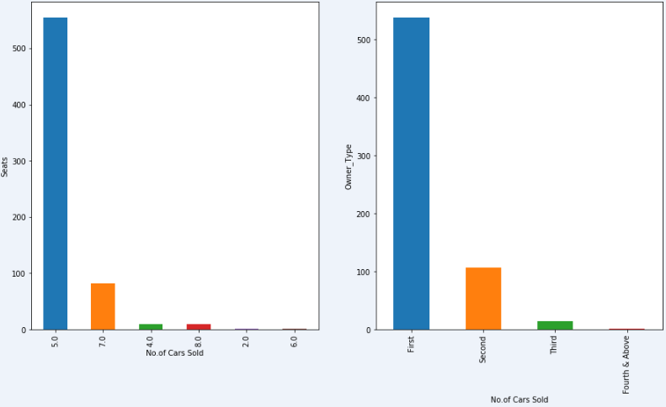

Slide 9
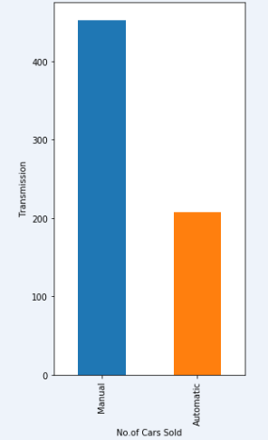
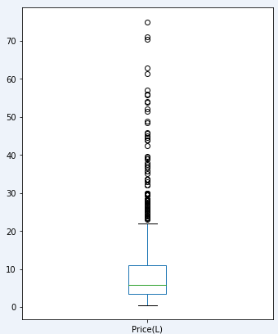
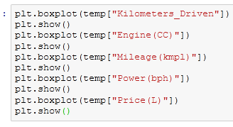
We usually use Matplotlib.pyplot library or we can also use seaborn library available in python to plot
Numerical data
Code:

Slide 10
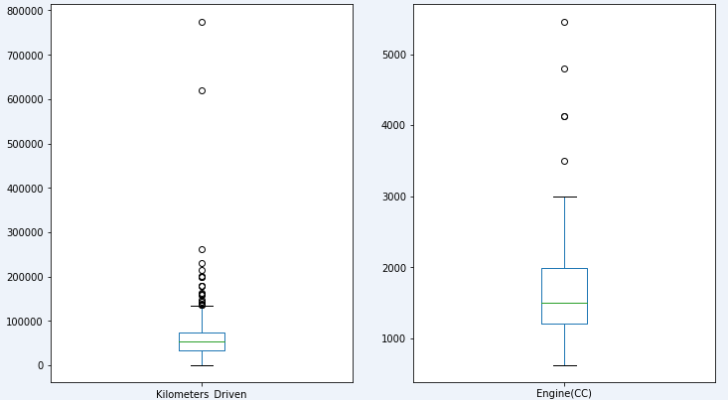
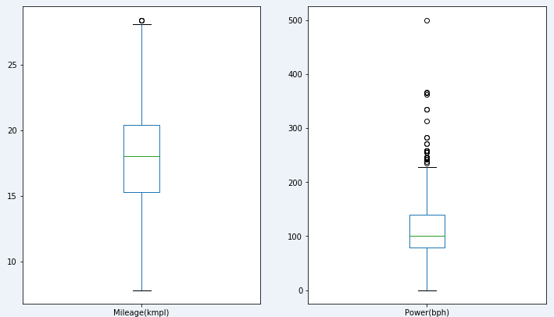

Slide 11
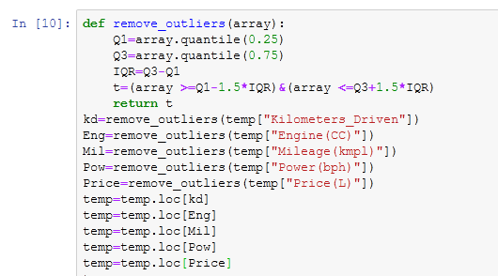
Removal Outliers :
As we have seen in the boxplot there were so many outliers these outliers have to be removed. We filter the outliers using inter quartile region approach. The values lying less than Q1-1.5*IQR and greater than Q3+1.5*IQR are removed.
Code :

Slide 12
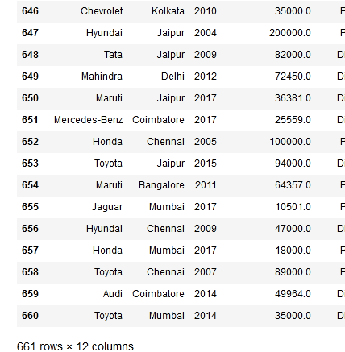
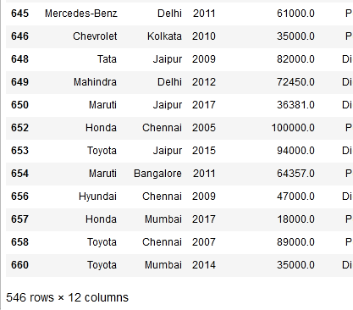
before removing outliers
After removing outliers

Slide 13
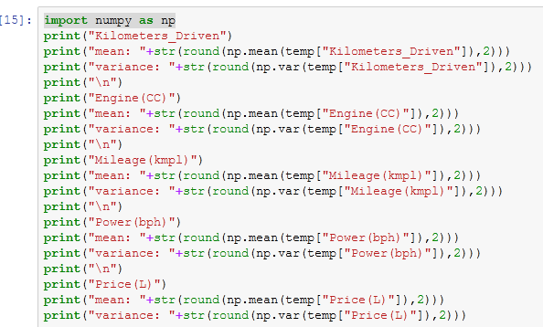
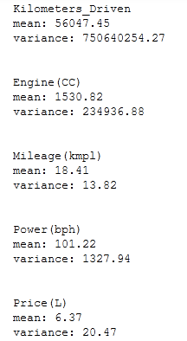
3.Normalization and Standardization
For numerical data mean and variance should be calculated. We have used numpy library for obtaining mean and variance.
Code : Output :

Slide 14
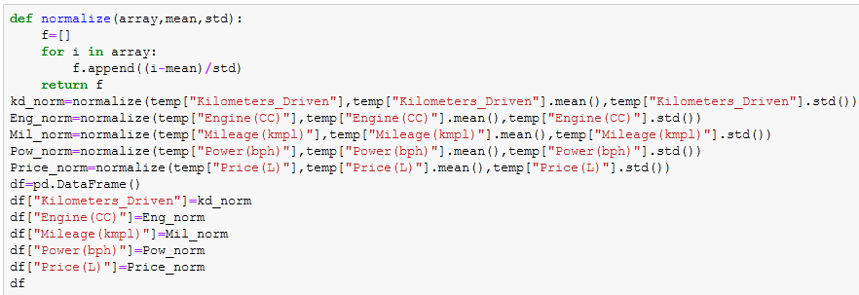
Normalization of the data (for numerical data) is essential as many data’s with different mean and variance is difficult to examine so it is converted to a standard form of mean = 0 and standard deviation (or) variance =1 values ranging in the interval (-3,3)
So it could easily be examined
Code to normalize he data :

Slide 15
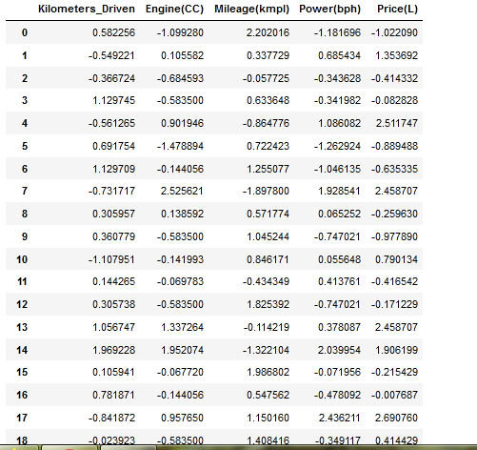
Normalized data
from this we can also check whether the given data follow normal (guassian) distribution or not by plotting histograms and observing shape of the curve

Slide 16
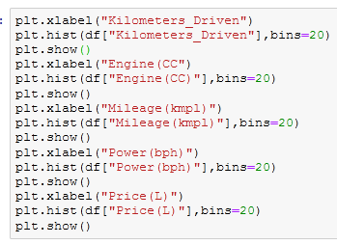
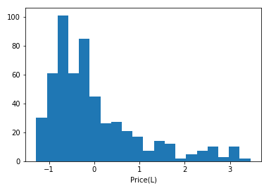
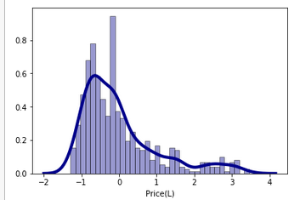
Code to plot histograms :
Output:
Does not follows normal plot (it is right skewed data)

Slide 17
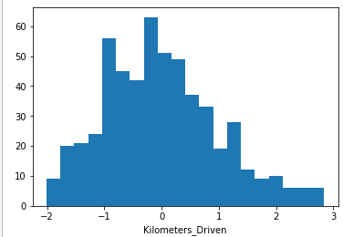
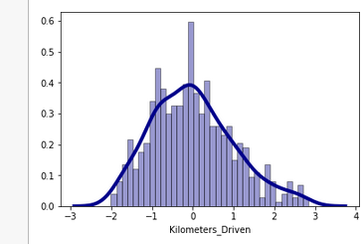
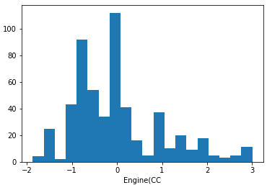
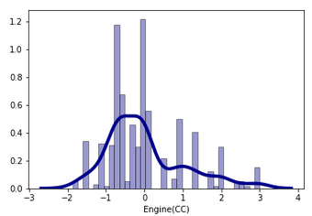
Approximately follows normal plot
Does not follows normal plot (it is right skewed data)

Slide 18
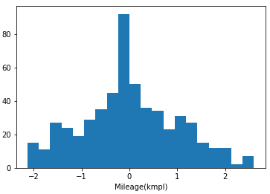
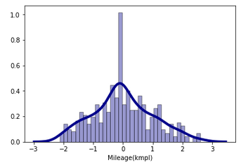
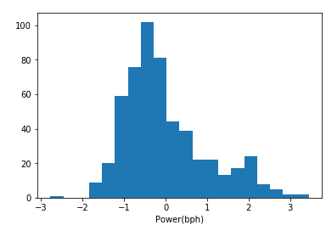
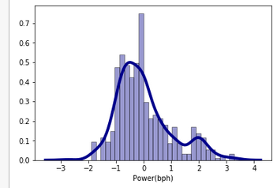
Approximately follows normal plot
Does not follows normal plot (it is right skewed data)

Slide 19
4.Hypothesis Testing
Here we draw random sample (since our data set is the population) from the dataset and state null hypothesis and alternative hypothesis. Then we perform some operations so whether to reject the null hypothesis or accept it.
It is done for numerical data mainly to compare the hypotheses parameters with the sample parameters (mean, std, proportions).

Slide 20
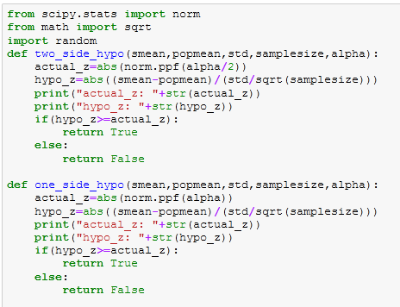
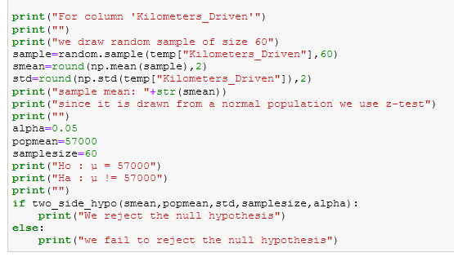
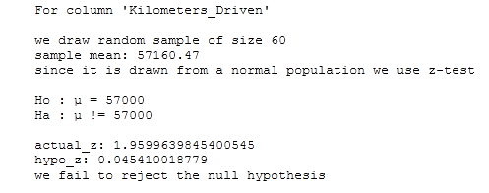
Hypothesis Testing
Code for Column 1:
Output:

Slide 21
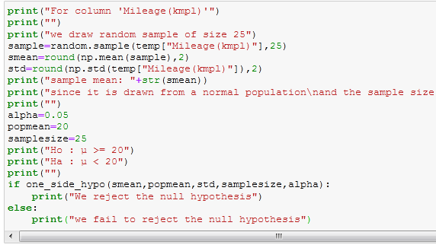
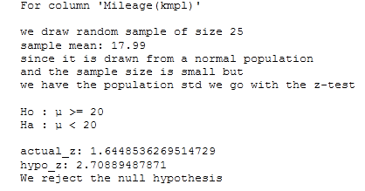
Hypothesis Testing
Code for Column 2:
Output:

Slide 22
THANK YOU

